Slide 1
Put Your
Prospect’s Logo
Here

Slide 2


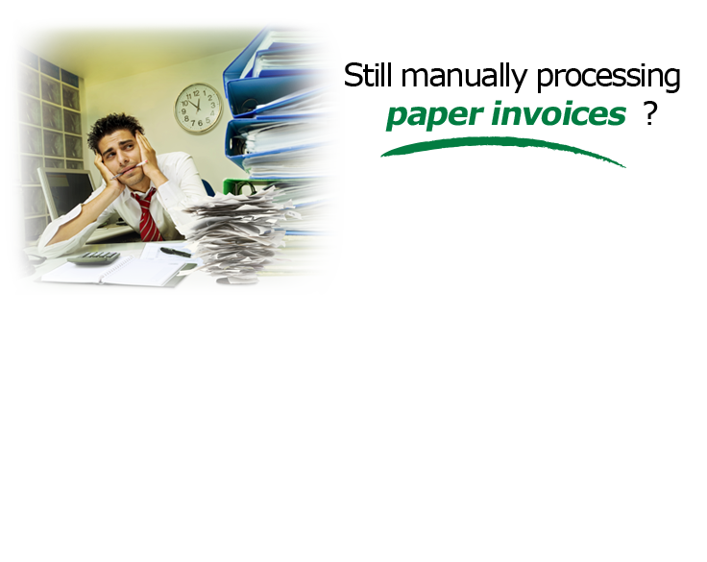
PVE WorkFlow Grabber here

Slide 3





Slide 4
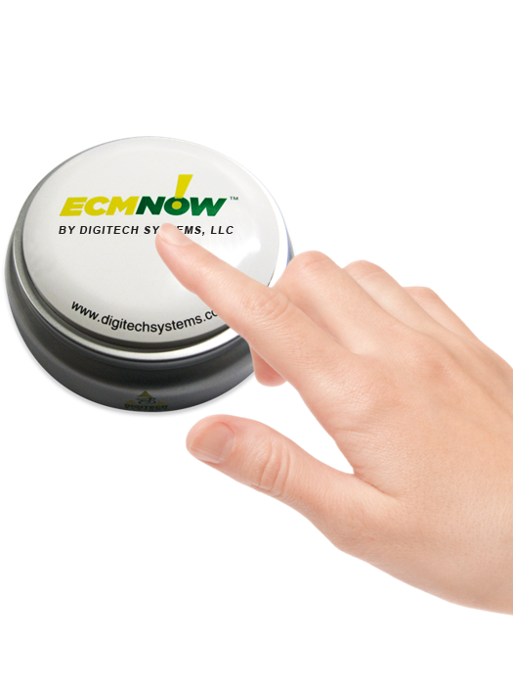
Accounts Payable (AP)
Affordable
  Save money by decreasing
  your cost per invoice
Easy
  Eliminate manual data entry by extracting invoice data automatically
NOW!
  Automate and speed up invoice processing times

Slide 5
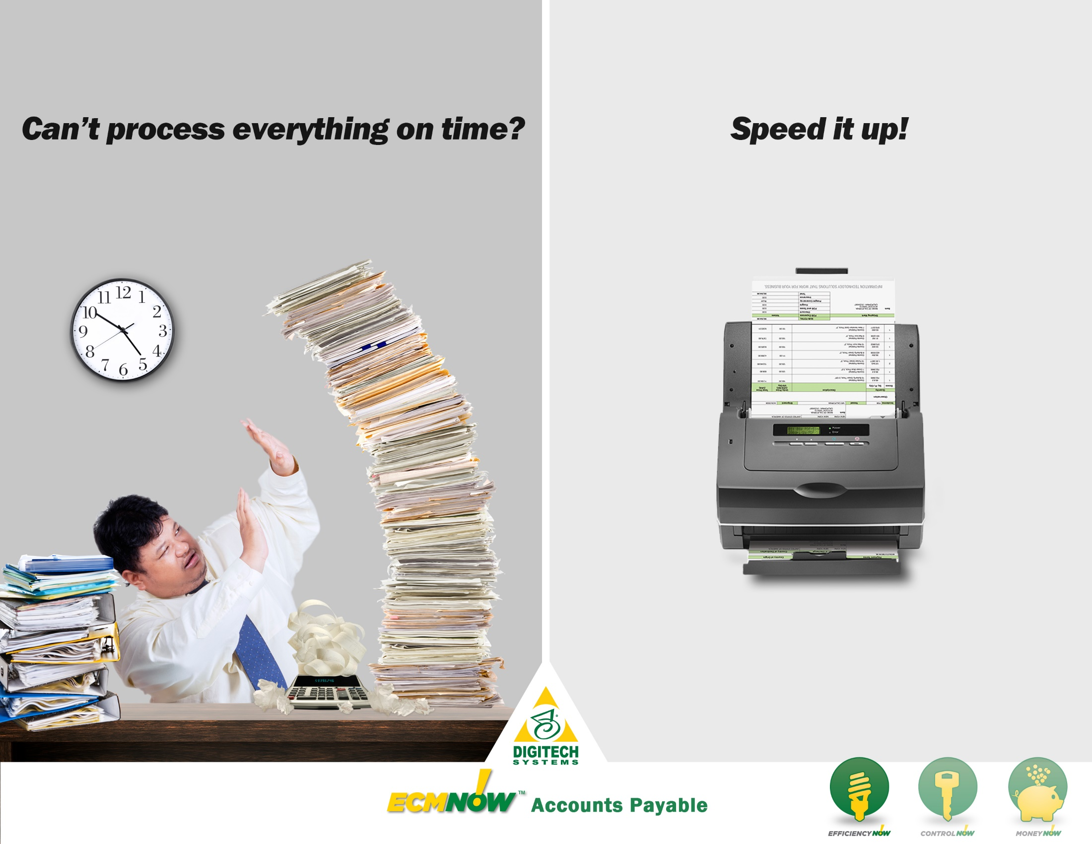
Efficiency Claims Visual

Slide 6


Artificial intelligence extracts invoice
data eliminating manual data entry
Effortlessly cross-reference
purchase orders, invoices, and
delivery information
Route invoices, reconcile and
remit payments through
automated procedural steps

Slide 7




We needed a better system than piles of paper so we centralized the accounts payable operations and implemented ImageSilo® and PaperVision® Enterprise WorkFlow. We create images rather than papers, and we automatically route documents through the organization. Processes move faster, problems get solved and business gets done. CMC is estimated to save in labor efficiencies alone $400,000 annually.
Alberto Centeno
Director of Shared Services

Slide 8
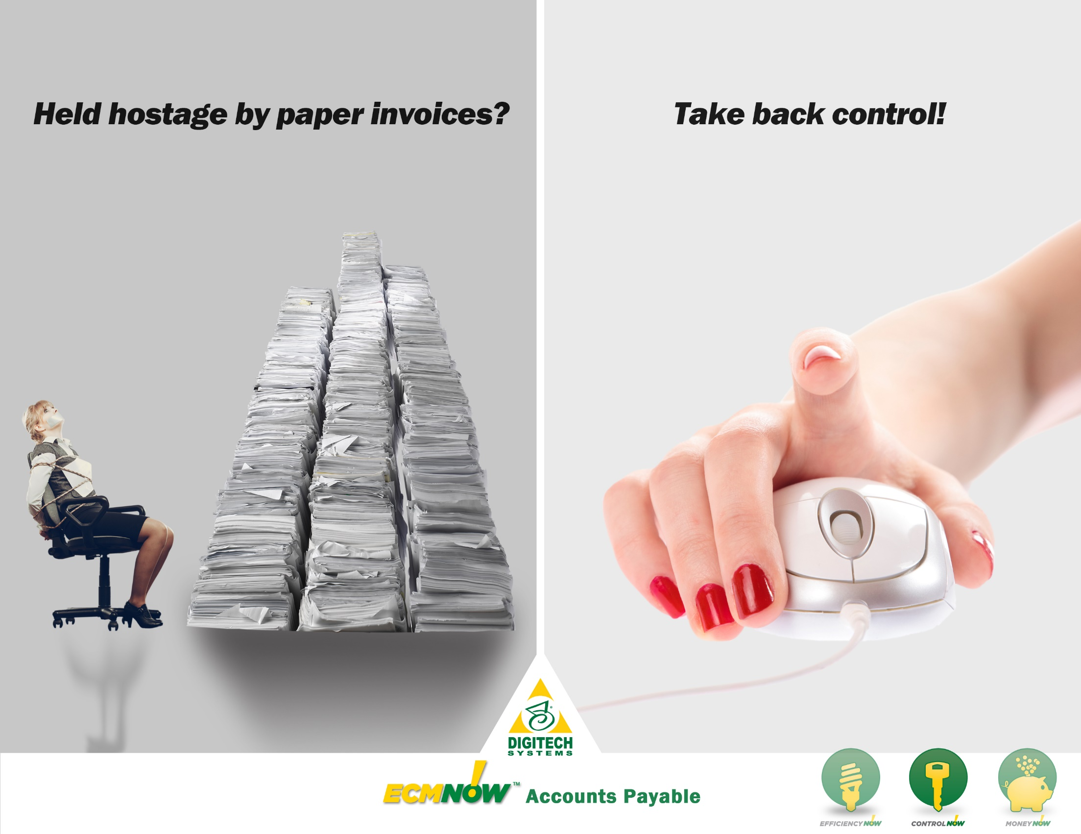
Control Claims Visual

Slide 9


Scan paper invoices to protect
sensitive data and to ensure
accurate payments
Eliminate fraud by applying internal controls to every invoice
Use retention locks to protect
financial records from accidental deletion

Slide 10


We use ImageSilo® for just about anything you
can imagine: AP processing, bank statements,
truck manifests, and anything else we would need
to keep a paper copy of. We’re on our way to
being completely paperless. PaperVision®
Capture makes the setup pretty slick.
Pat Myers
Accounts Payable/Receptionist

Slide 11
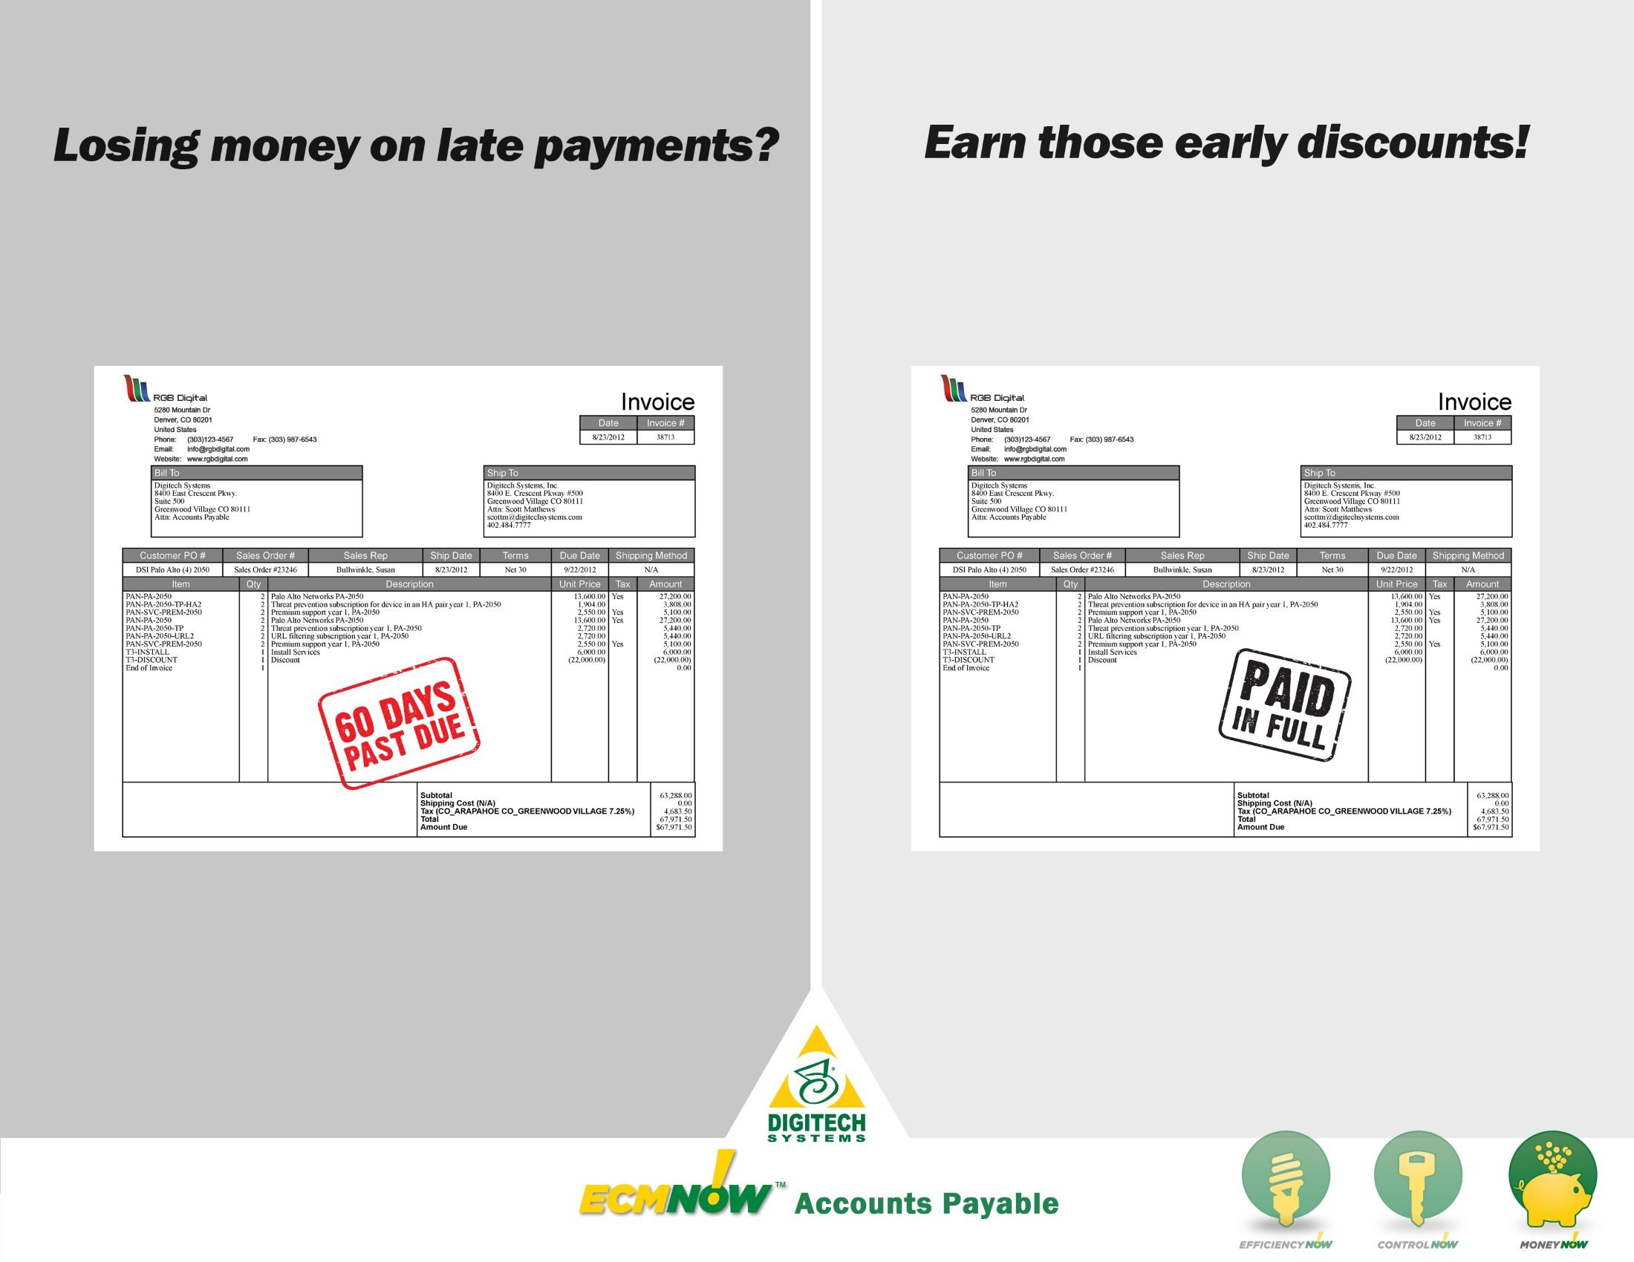
Money Claims Visual

Slide 12


Speed up invoice approvals to
earn more early discounts
Reduce audit fees by simplifying
record management and retrieval
Reduce your cost per invoice by managing files electronically

Slide 13


PaperVision® Forms Magic has revolutionized our AP processes! We’ve lowered the processing cost per invoice by more than $40 per invoice processed, saving the company more than $676,000 annually. We’re saving the organization money and improving relationships with our business partners. We love Forms Magic!
Jason Sojka
Network and Computer Systems Manager

Slide 14


Slide 15





Increase
efficiency
by eliminating manual data entry and invoice sorting.
Ensure accurate payments and reduce fraud
with automatic data and
process
control.
Save
money
by reducing audit fees and earning more early payment discounts.

Slide 16
WHAT DO
YOU THINK?

