Slide 1
Put Your
Prospect’s Logo
Here

Slide 2


PVE WorkFlow Grabber here

Slide 3





Slide 4

PaperVision® Forms Magic Technology
Affordable
  Automatically extract data to
  save money.
Easy
  Set up forms fast with only a few setup documents needed.
NOW!
  Drop advanced forms processing—driven by our unique machine learning engine—into almost any existing front-end system.

Slide 5
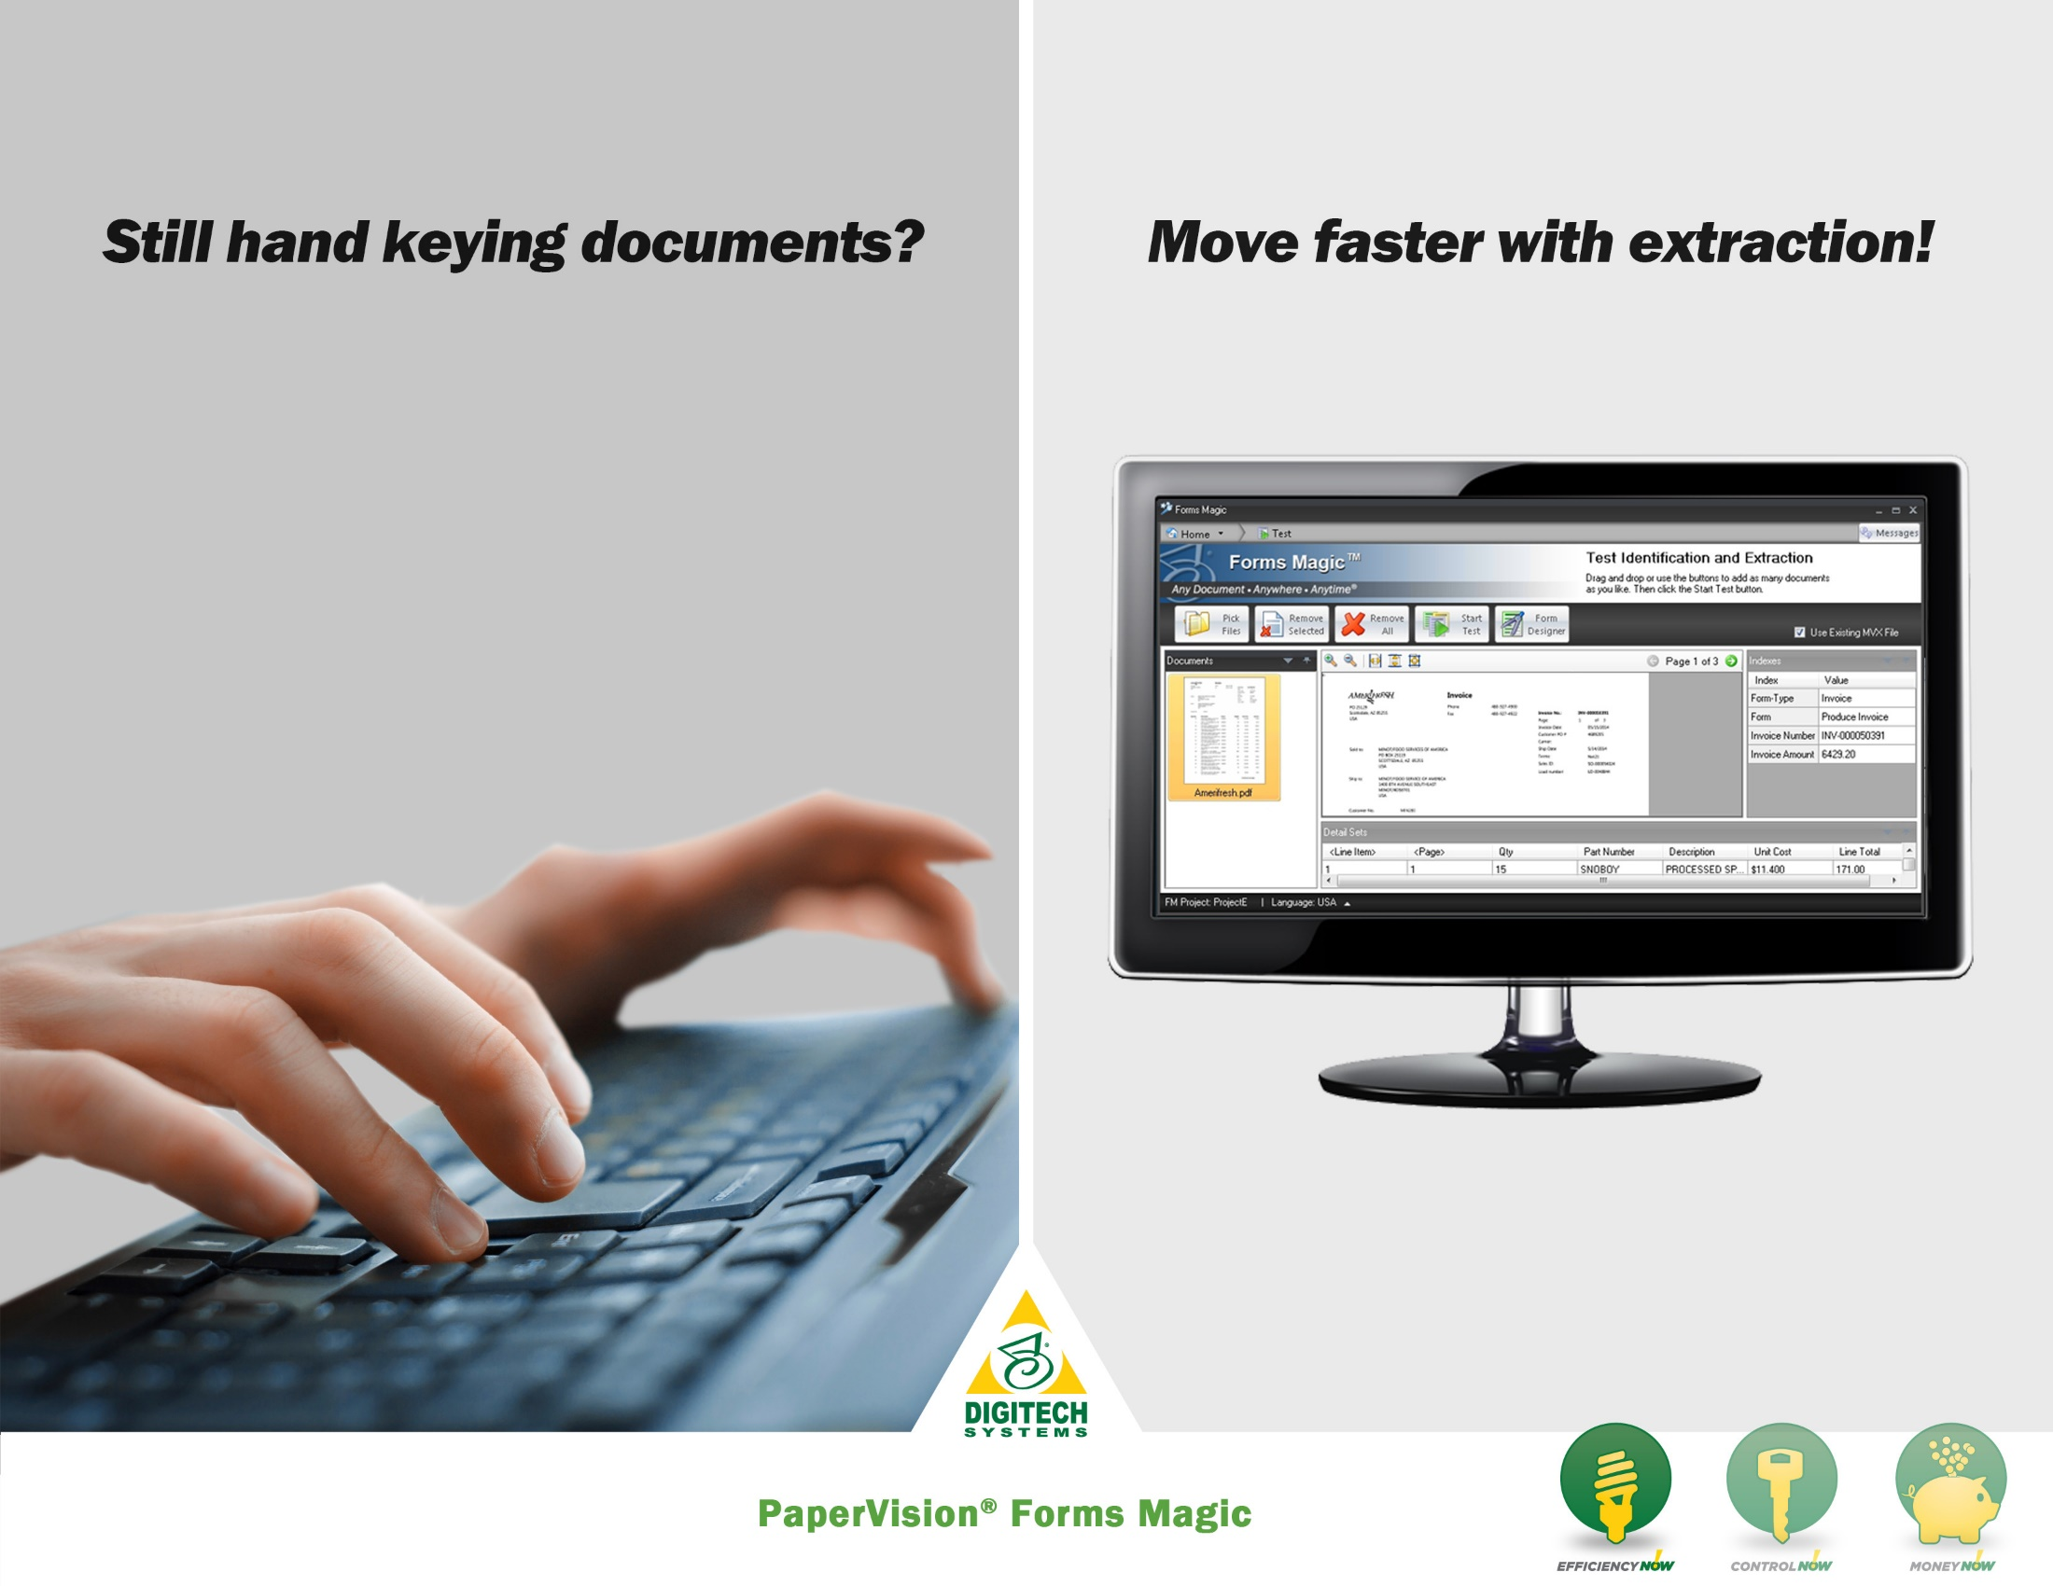
Efficiency Claims Visual

Slide 6


Artificial intelligence engine begins recognizing documents immediately
Eliminate manual data entry by
extracting data automatically
Integrate fully into your business processes

Slide 7


PaperVision Forms Magic has streamlined our client’s information management services. Sorting through documents prior to scanning is no longer required, and the system automatically extracts all the data needed. As a result, business moves faster and more effectively.
The system is great!
Bruce Rector
MuniMetriX Corp

Slide 8
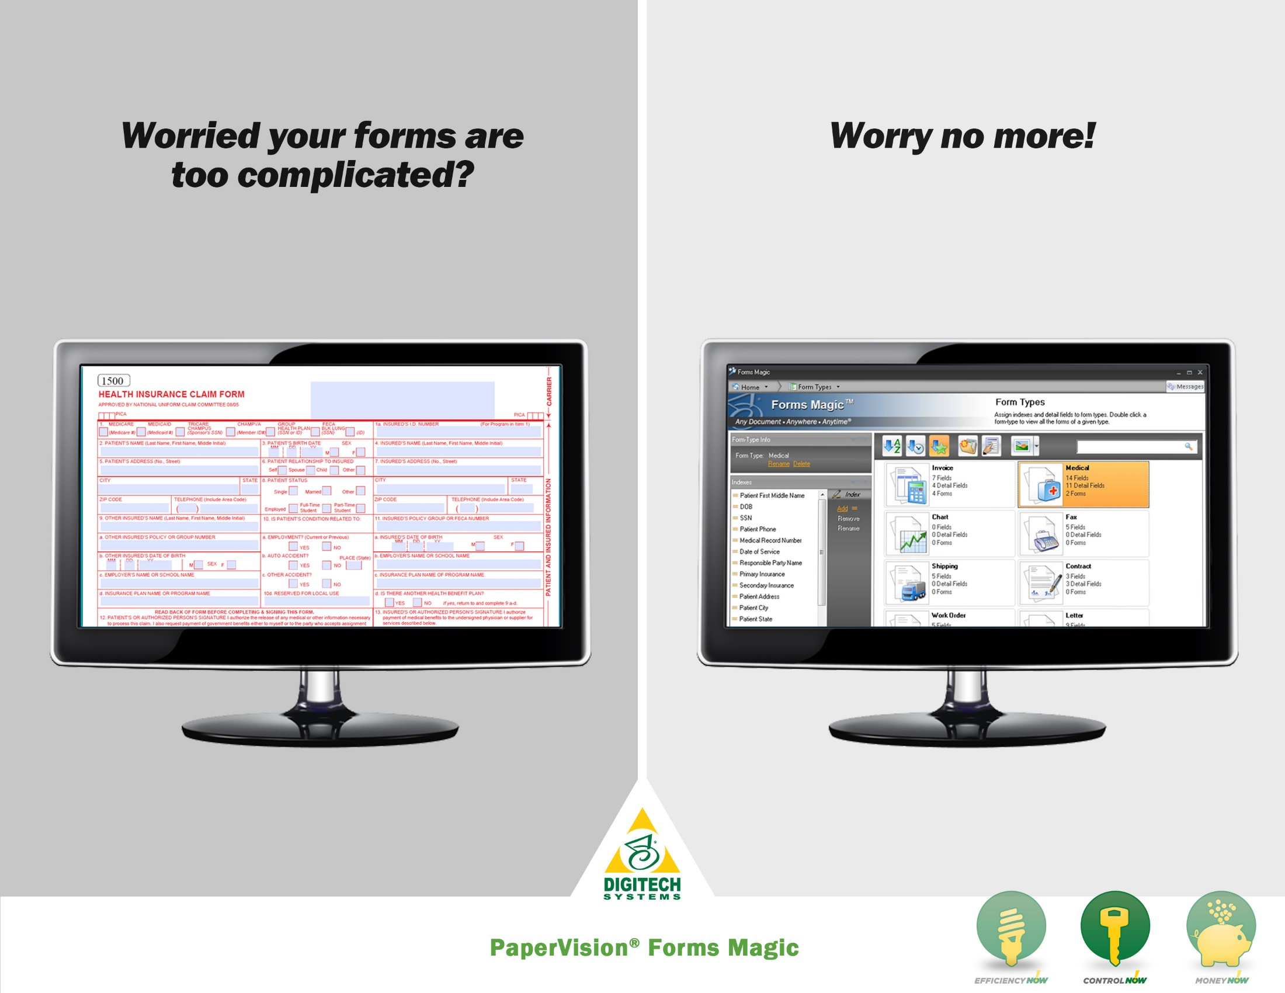
Control Claims Visual
Control claims visual

Slide 9


Classify automatically with
accuracy rates up to 95%
Extract critical business data
eliminating errors
Secure vulnerable paper
records to improve document
security

Slide 10

In my 25 years of document management experience, PaperVision Forms Magic brings something that no other forms processing technology can mimic. It offers faster implementation and more accurate classification results than anything I’ve worked with. I believe it will revolutionize the industry.
Dave Clark
Digitech Systems Professional Services

Slide 11

Money Claims Visual
Money claims visual

Slide 12


Improve cash flow by speeding up
information processes
Reduce time-to-payment
schedules
Minimize costly keystrokes
with data extraction

Slide 13

PaperVision Forms Magic has revolutionized our AP processes! We've been able to cut our invoice processing time by over 75%. We're saving the organization money and improving relationships with our business partners. We love PaperVision Forms Magic!
Jason Sojka
MSI Mold Builders

Slide 14


Slide 15






Enhance efficiency
by utilizing ECMNOW! to manage your documents.
Securely organize your records and gain more control of your business.
Save money by reducing information management costs with electronic records.

Slide 16
WHAT DO
YOU THINK?

